Slide 1
IAP.SIDN ‘20
Interactive Methods
Hendrik Strobelt (MIT-IBM AI Lab),
Sebastian Gehrmann (Harvard SEAS),
David Bau (MIT CSAIL)

Slide 2
Prerequisites for lab #2 (conda might take time)
checkout github: http://bit.ly/SIDN-AttnVis git clone https://github.com/SIDN-IAP/attnvis.git cd attnvis
install dependencies: conda env create -f environment.yml
get server to start without errors conda activate attnvis python server.py

Slide 3
bit.ly/sidn-gp
Lab part 1: direct interaction

Slide 4
Exercise 1 (3 mins)
bit.ly/sidn-gp
Directly visualize the activations of a unit of the GAN.
How many numbers are contained in the activations tensor? Use activations.shape to see its dimensions.
Change the visualization to visualize other units like 221, 384, or 310. How do you think these behave on other images?

Slide 5
Exercise 2 (5 minutes)
bit.ly/sidn-gp
Let’s probe the activations by region instead of by unit, using a PaintWidget
Run the code and interact with the widget.
Change the line where mean is computed (about line 13) to compute the (positive) maximum of each channel within the selected area, instead of the weighted mean.

Slide 6
Exercise 3 (5 minutes)
bit.ly/sidn-gp
Run the widget and experiment with painting rules.
Can you find units that allow doors to be drawn? Try probing above using PROBE_IMGNUM of 13 and probing for the active units of the door.
Add doors to an image, trying in CANVAS_IMGNUM 70. Where can doors be drawn? Are there places that a door cannot be drawn?
Now try changing images and regions and units. Can you draw trees?

Slide 7
Solutions
bit.ly/sidn-ganpaint-sol

Slide 8
IAP.SIDN ‘20
Interactive Methods
Hendrik Strobelt (MIT-IBM AI Lab),
Sebastian Gehrmann (Harvard SEAS),
David Bau (MIT CSAIL)

Slide 9
Why ?
Interactive methods help:
to generate hypotheses around model behavior or dataset
when the exploration space is too large for brute-force methods
asking counterfactual “what if” questions to model and data
Interactive methods can enable:
application of methods to real-world problems
teaching by lowering the entry barrier
visibility and feedback for new methods

Slide 10
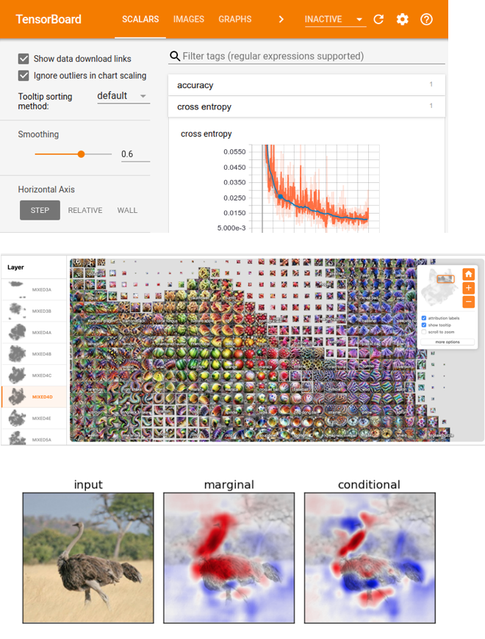
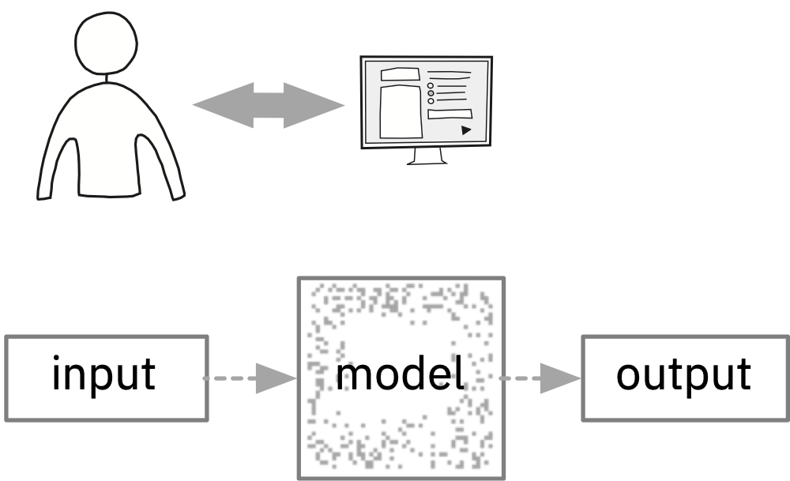
Examples: Passive Observation

Slide 11
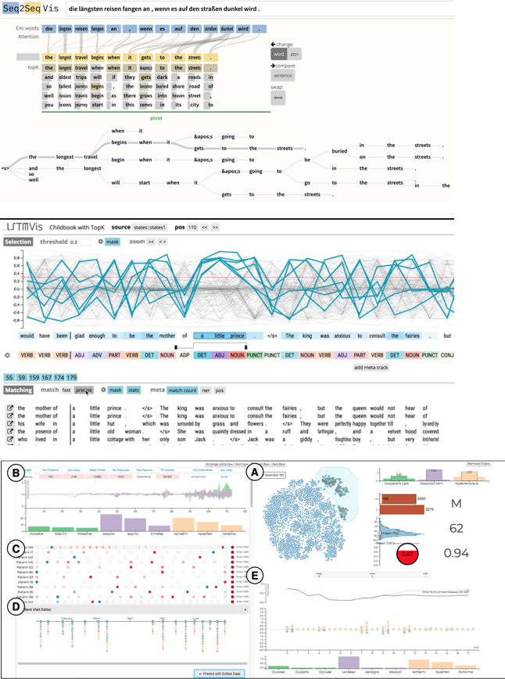
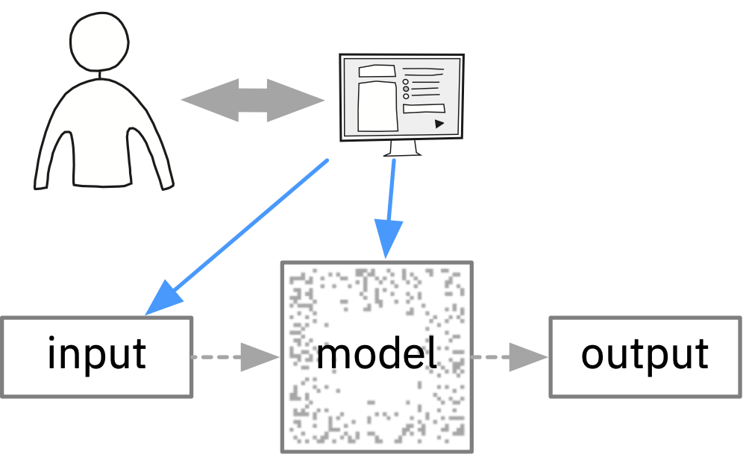
Examples: Interactive Observation

Slide 12
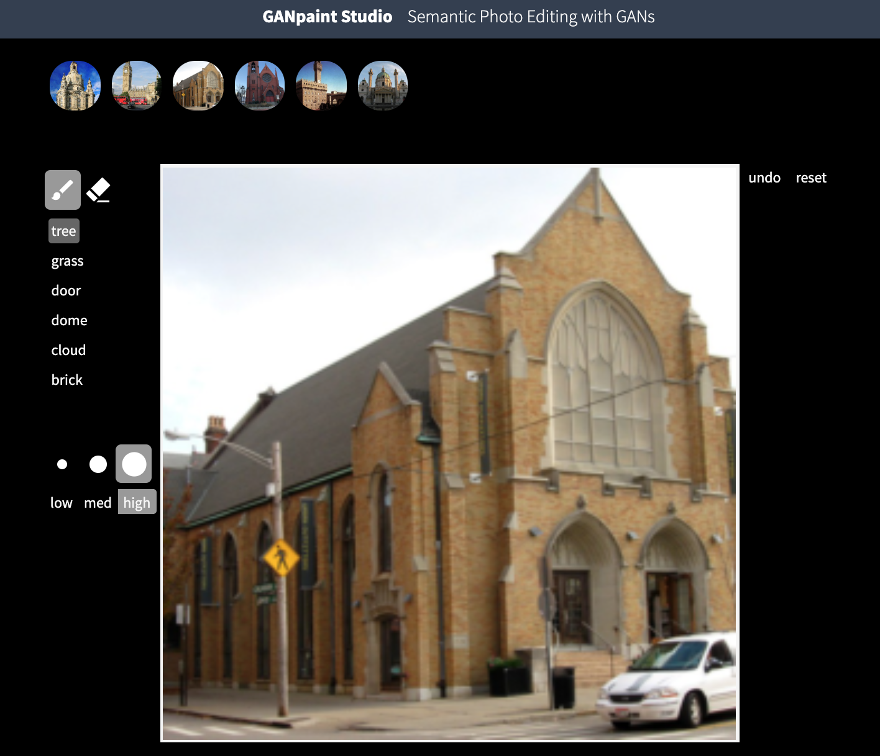
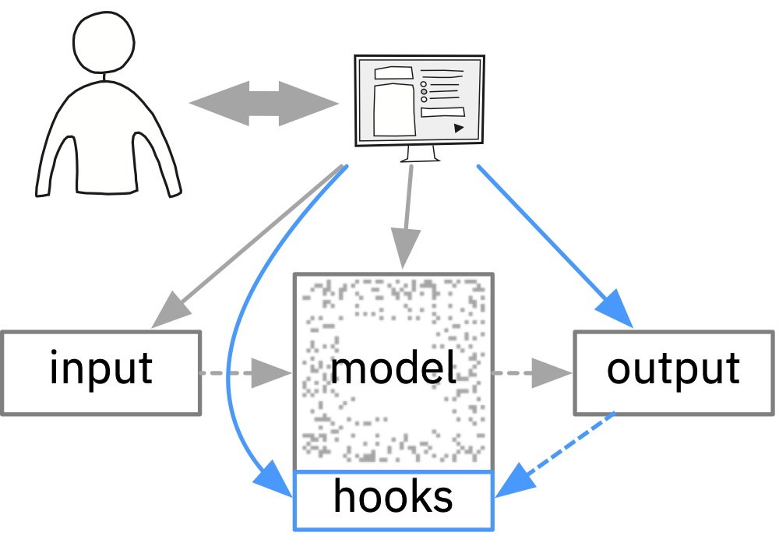

Examples: Interactive Collaboration

Slide 13
How ?
Low Fidelity Prototypes
Iteration is iteration is … is key to good ideas/design
formulate goals precisely
run prototype by your friends to avoid tunnel ‘depression’

Slide 14
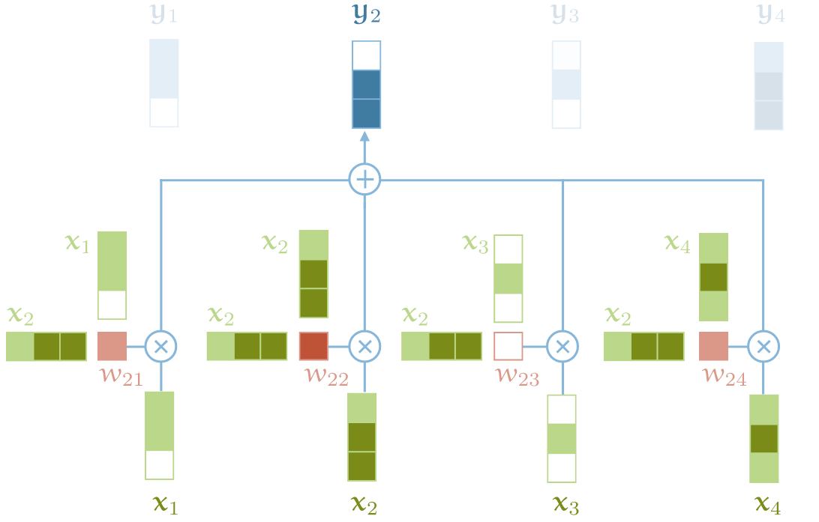
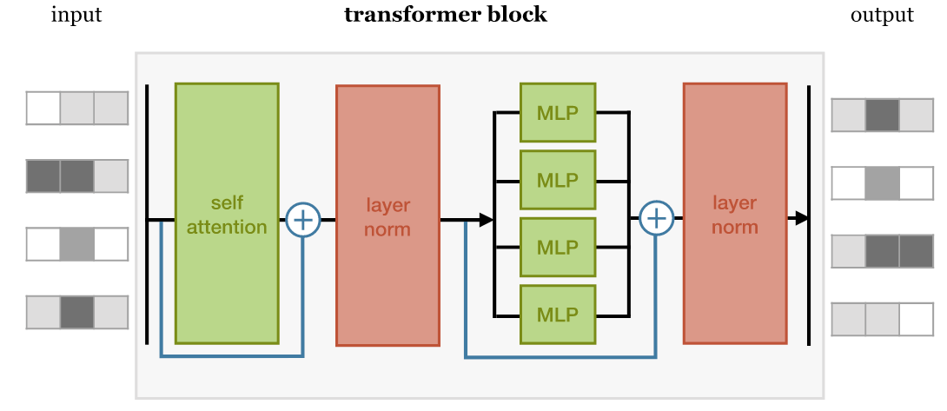
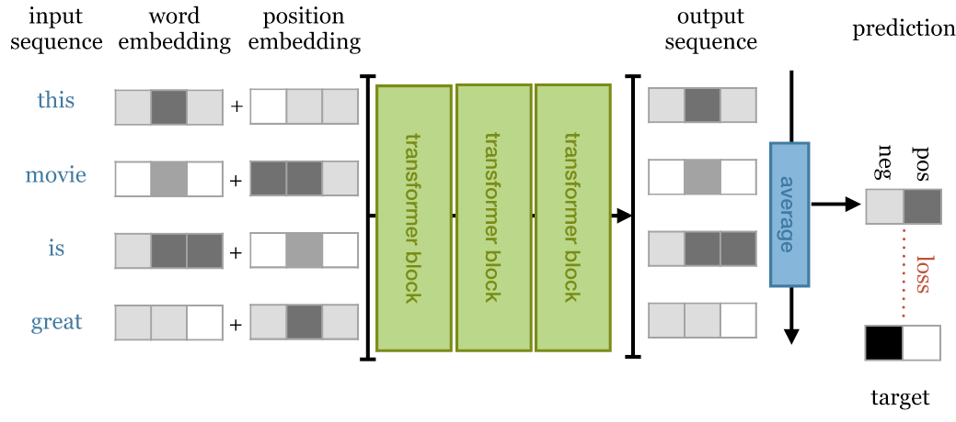
Self Attention in Transformer Models (NLP)
http://www.peterbloem.nl/blog/transformers

Slide 15
Activity: Low Fidelity Prototypes
Sketch three ideas how you would visualize one attention head in a transformer model.
(3 min)

Slide 16
The 1-day JS Prototype
checkout github: http://bit.ly/SIDN-AttnVis git clone https://github.com/SIDN-IAP/attnvis.git cd attnvis
install dependencies: conda env create -f environment.yml
get server to start without errors conda activate attnvis python server.py

Slide 17
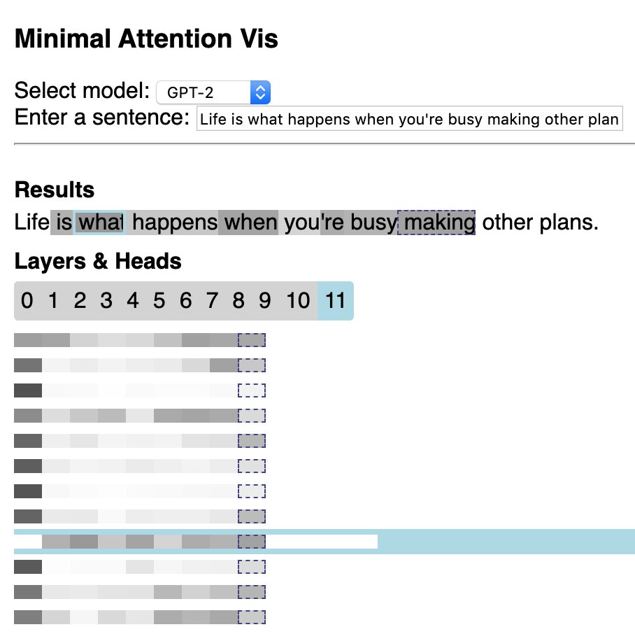
The 1-day JS Prototype
Python
Javascript / HTML / CSS
MODEL
(api.py)
REST interface
(server.py)
JS interface + VIS
(index.html)
huggingface
pytorch
flask
html/css/js d3.js

Slide 18
some links
Collaborative Semantic Inference http://c-s-i.ai
LSTMVis http://lstm.seas.harvard.edu/
Seq2SeqVis https://seq2seq-vis.io/
GanPaint https://gan-paint-demo.mybluemix.net/

